Slide 1

TECH 1004 & TECH 1004 UAC AI Technologies
Evolutionary Algorithms
By Dr Hu Wang, Wei Zhang

Slide 2

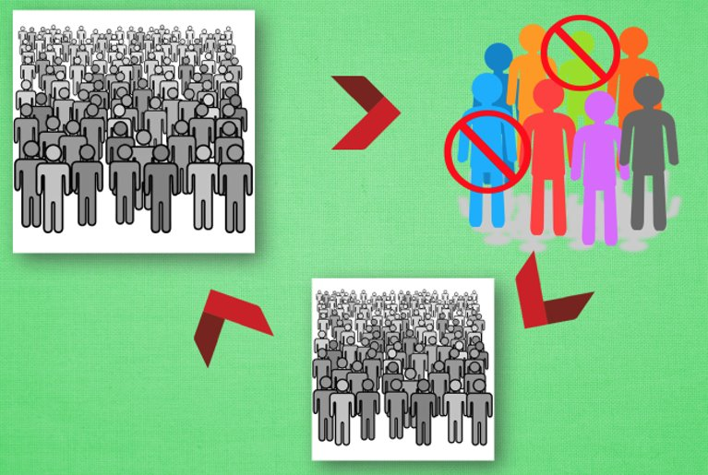
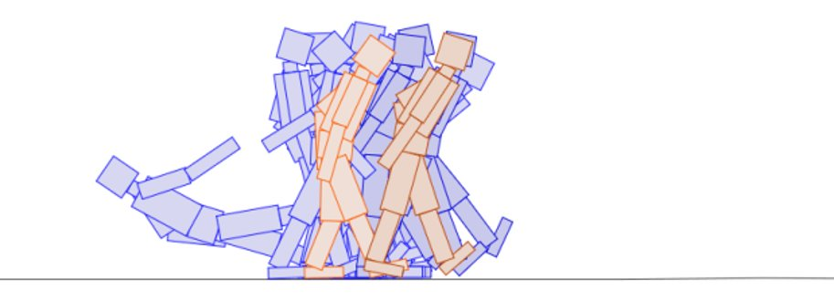
Evolutionary Algorithm

Slide 3
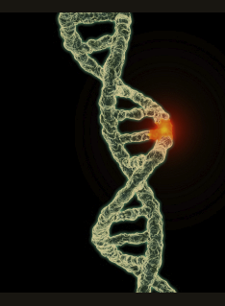
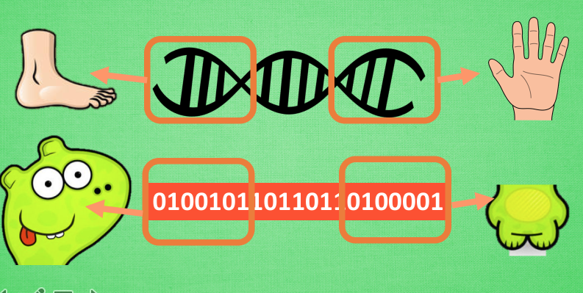
Genetic Algorithms

Slide 4
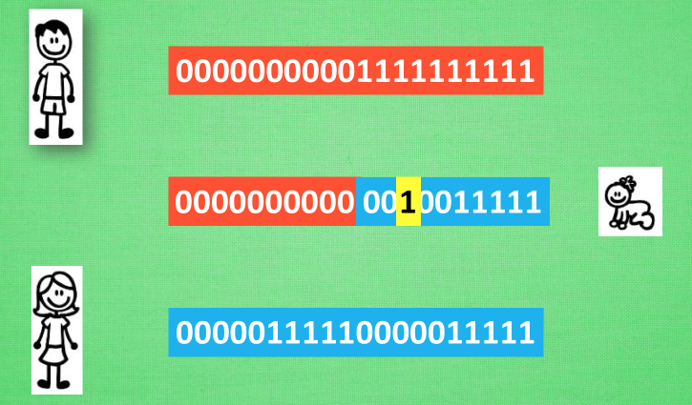
Genetic Algorithms

Slide 5
Genetic Algorithms
Genetic Algorithm (GA) is modelled after evolution – or at least uses evolution as a metaphor.
Individuals (as a species) evolve over generations.
Evolution relies on generational change.
⁾ If offsprings (children) are exact replicas the mother (or the father), there will be no evolution. . .
Change at the genetic level through division of cells.
⁾ Type-I cell division, mitosis
⁾ takes place throughout the body, responsible for growth
⁾ a fertilised egg of microscopic size becomes a big elephant.
⁾ Type-II cell division, meiosis
⁾ takes place in special regions of the body, produces germ cells
⁾ male: in the testicles, produces sperm cells
⁾ female: in the ovaries, produces egg cells (ova, plural of ovum)
⁾ Meiosis is the basis of generational change.

Slide 6
What happens during meiosis?
One normal cell (2n chromosomes) produces four germ cells (n chromosomes each)
⁾ In case of egg cells, three disintegrate, only one egg is produced
Each normal cell has n chromosome pairs
⁾ one from father, one from mother – both for similar functions
⁾ Say: F₁M₁, F₂M₂, F₃M₃, F₄M₄
⁾ F_{i} from father, M_{i} from mother
A germ cell inherits one from each pair of these chromosomes
⁾ F₁, F₂, M₃, F₄
⁾ F₁, M₂, M₃, F₄
⁾ M₁, F₂, M₃, F₄
⁾ . . .
Not every egg/sperm cells of the same individual are same!
⁾ Else all siblings will be clones of each other!
Further change is introduced by crossover and mutation.
Note: Through fertilisation the chromosomes get paired, producing a cell with 2n chromosomes ready for mitosis. . .

Slide 7
Mutation and Crossover in Meiosis
Consider chromosome pairs
F₁M₁, F₂M₂, F₃M₃, F₄M₄ (Figure: next Slide)
Each chromosome is a sequence of genes
⁾ Think of a gene as a typed variable (can take an appropriate value)
Eg. one gene for eye colour – blue, brown, gray,. . .
⁾ in a chromosome pair, both chromosomes “match” – eg., 3rd place in both the sequences are genes for hair colour.
Consider the germ cell F₁, F₂, M₃, F₄
⁾ The chromosome F₂ was obtained from the pair F₂M₂
⁾ F₂ and M₂ are matching sequences of genes
⁾ There could be exchange of genetic material (crossover) between two sequences
Eg. last 4 genes of F₂ get swapped by last 4 genes of M₂
⁾ So instead of germ cell F₁, F₂, M₃, F₄
We might get F₁, F ₂, M₃, F ₄
Mutation is not as well understood – could be because of “copy-paste” error, or other reasons

Slide 8
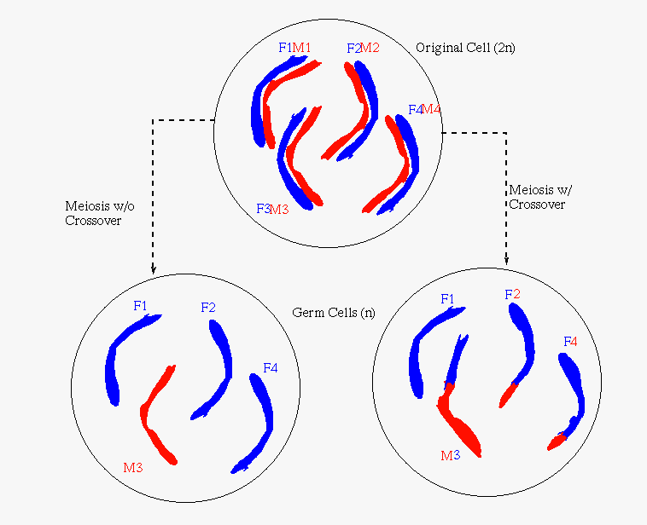
Mutation and Crossover in Meiosis
Figure: Meiosis – without and with crossover

Slide 9
Genetic Algorithms
Genetic algorithms are a randomized heuristic search strategy.
Basic idea: Simulate natural selection, where the population is composed of candidate solutions (individuals, chromosomes).
Focus is on evolving a population from which strong and diverse candidates can emerge via mutation and crossover.

Slide 10
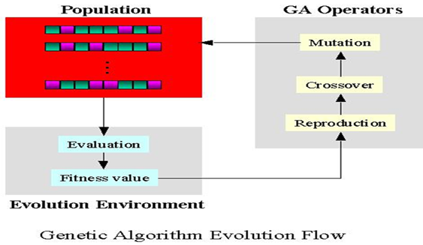
Genetic Algorithm – Basic Algorithm
Create an initial population.
While the best candidate so
far is not a solution:
– Create new population using
successor (mutation, crossover) functions.
– Evaluate the fitness of each
candidate in the population.
Return the best candidate found

Slide 11
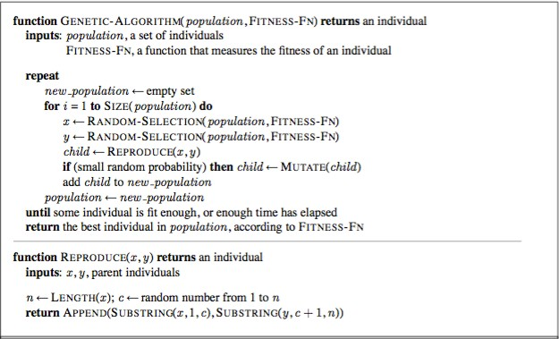
A bit more concrete
Note: There are variants where reproduce (x, y) produces two offsprings.
The algorithm gets adjusted accordingly.

Slide 12
A Simple Example: evolution of alternating strings
Let’s try to evolve an alternating string of length 4
Initial population:
⁾ C1 = 1000
⁾ C2 = 0011
We roll the dice and the offsprings are. . .
⁾ C3 = cross (C1, C2) = 1011
⁾ C4 = cross (C1, C1) = 1000.
We mutate C3 and the fourth bit flips, giving
⁾ C3’ = 1010
⁾ We mutate C4 and get C4’ = 1000
We run our solution test on each.
⁾ C3’ is a solution, so we return it and are done.

Slide 13
Basic Components of GA
Candidate representation
⁾ Important to choose this well.
⁾ More work here means less work on the successor functions.
Successor function(s)
⁾ Mutation
⁾ Crossover
Fitness function
Solution test
Some parameters
⁾ Population size
⁾ Generation limit

Slide 14
Candidate Representation
We want to encode candidates in a way that makes mutation and crossover easy.
The typical candidate representation is a binary string.
⁾ This string can be thought of as the genetic code of a candidate – hence the term “genetic algorithm”!
⁾ Other representations are possible, but they make crossover and mutation harder.

Slide 15
Successor functions
Mutation – Given a candidate, return a slightly different candidate.
Crossover – Given two candidates, produce one that has elements of each.
Other less used successor functions exist
Check: the successor is a legitimate candidate!
Need not generate a successor for each candidate.
⁾ We generate a successor population based on the candidates in the current population, weighted by fitness.

Slide 16
Successor functions
Mutate(c):
⁾ copy c as c′
⁾ For each bit x in c′, flip x with probability p
⁾ Return c′
Cross(c₁, c₂): Create a candidate c such that
⁾ c[i ] = c₁[i ] if i %2 = 0
⁾ c[i ] = c₂[i ] otherwise.
Return c.
⁾ Any other scheme such that c gets roughly equal information from c1 and c2 will do.

Slide 17
Less used Successor functions
Invert(c):
⁾ copy c as c′ front to back
⁾ Return c′
Exchange(c):
⁾ copy c as c′
⁾ Randomly pick two indices i , j ≤ max index (c′)
⁾ Swap c′[i ] with c′[j] in c′
⁾ Return c′

Slide 18
Example: Successor functions
Mutate(101010)
⁾ Let the last bit flip. Returns 101011
Cross (101010, 110010)
⁾ Returns 111010
Invert(101010)
⁾ Returns 010101
Exchange (101010)
⁾ Returns 111000
Note: all successors are legitimate assignments!

Slide 19
Fitness function
The fitness function is analogous to a heuristic that estimates how close a candidate is to being a solution.
In general, the fitness function should be consistent for better performance. However, even if it is, there are no guarantees. This is a probabilistic algorithm!
For example, in case of a classification rule, one possible fitness function would be information gain over training data.

Slide 20
Example : Fitness function
How about the numbers of bits that have the correct value?
⁾ Not the best approach. Why?
How about the numbers of clauses that are satisfied?
⁾ Fitness(110010) = 1.
⁾ Fitness(010011) = 3.
⁾ Fitness(101011) = 5.
⁾ Uses the Divide and Conquer strategy – counts the number of problem components satisfied.

Slide 21
Solution test
Given a candidate, return whether the candidate is a solution.
Often just answers the question does the candidate satisfy some set of constraints?
Optional! Sometimes you just want to do the best you can in a given number of generations.
In Example 1, a candidate is a solution if it satisfies each of the five clauses.

Slide 22
New population generation
How do we come up with a new population?
⁾ Given a population P, generate P′ by performing crossover |P| times, each time selecting candidates with probability proportional to their fitness.
⁾ Get P′′ by mutating each candidate in P′.
⁾ Return P′′.
Optionally do inversion and exchange. . .
This is just one approach – be creative!
⁾ It doesn’t explicitly allow candidates to survive more than one generation – this might not be optimal.
⁾ Crossover is not necessary, though it can be helpful in escaping local maxima.
⁾ Mutation is necessary (why?).

Slide 23
The Traveling Salesman Problem
A sales person is required to visit N cities in a sales route. There is a cost involved in each leg of the route (milage, ait fare, time?). Find the least cost path for the salesperson to start at one city, visit each other city exactly once, and return home.
There are N! States to be considered. An NP-hard problem.
The Traveling Salesman Problem (TSP) has many interesting applications
⁾ Circuit Board Drilling
⁾ X-ray crystallography
⁾ Routing in VLSI fabrication
Tens of thousands of points (cities!) need to be visited with a minimum cost path.
Can Genetic Algorithm possibly help?

Slide 24
TSP: Representation I
Let’s assume 9 cities in the TSP: 1, 2, . . . , 9
Represent each city as a four-bit pattern: 0001, 0010, . . . , 1001
Represent a path as a sequence of these cities
⁾ 0001 0010 0010 0011 0100 0101 0110 0111 1000 1001
represents the path 1 → 2 → 3 → 4 → · · · → 8 → 9 → 1
⁾ Spaces are there for easy reading. The candidate is really the binary string: 0001001000100011010001010110011110001001
How good is this representation?
⁾ Crossover: No good.
⁾ Some cities could be removed, and some cities visited more than once!
1001 city (9) may cross with 0110 (city 6) to generate 1111
(15) which is a non-city!
⁾ Mutation no good.
⁾ City 6 (represented 0110) may mutate to 1110 that is 14 which is not a city at all!
⁾ Inversion and Exchange appropriately formulated may work but perhaps not powerful enough!

Slide 25
TSP: Representation II
Why not use an alphanumeric string: say 123456789 or 769823145 for a path?
Mutation implemented as exchange of two cities is fine. . .
⁾ if 3 and 8 are exchanged in 123456789, we get 128456739 which is a legitimate path
Any way of shuffling the cities in the path is fine
Crossover is useless
⁾ 123456789 and 123456798 may cross to generate 123456788 in which city 8 is visited twice and city 9 is dropped out
Ordered Crossover: Child inherits “order information”
⁾ Select two cut-points; use them in both parents
⁾ P₁ = (192 || 4657 || 83); P₂ = (459 || 1876 || 23)
⁾ Chile templates: C₁ = (xxx ||4657 ||xx); C₂ = (xxx || 1876 ||
xx)
⁾ C₁ receives the rest from P₂ starting at 2nd cut-point:
⁾ c₁' = (239 || 4657 || 18)
⁾ Similarly c₂' = (39 || 1876 || 245)

Slide 26
Genetic Algorithms: Pros, Cons, etc.
Pros
⁾ Faster (and lower memory requirements) than searching a very large search space.
⁾ Easy, in that if your candidate representation and fitness
function are correct, a solution can be found without any explicit analytical work.
⁾ Implicit parallelism inherent in evolutionary operators
Cons
⁾ Randomized – not optimal or even complete.
⁾ Do not take advantage of domain knowledge
⁾ Can get stuck on local maxima, though crossover can help mitigate this.
⁾ It can be hard to work out how best to represent a candidate
as a bit string (or otherwise).
Related Technologies
⁾ Genetic Programming
⁾ Existing programs are combined to breed new programs
⁾ Artificial Life
⁾ Using cellular automata to simulate population growth

Slide 27
Genetic Algorithms: Pros, Cons, etc.
Pros
⁾ Faster (and lower memory requirements) than searching a very large search space.
⁾ Easy, in that if your candidate representation and fitness
function are correct, a solution can be found without any explicit analytical work.
⁾ Implicit parallelism inherent in evolutionary operators
Cons
⁾ Randomized – not optimal or even complete.
⁾ Do not take advantage of domain knowledge
⁾ Can get stuck on local maxima, though crossover can help mitigate this.
⁾ It can be hard to work out how best to represent a candidate
as a bit string (or otherwise).
Related Technologies
⁾ Genetic Programming
⁾ Existing programs are combined to breed new programs
⁾ Artificial Life
⁾ Using cellular automata to simulate population growth
Artificial Intelligence (2018)

Slide 28
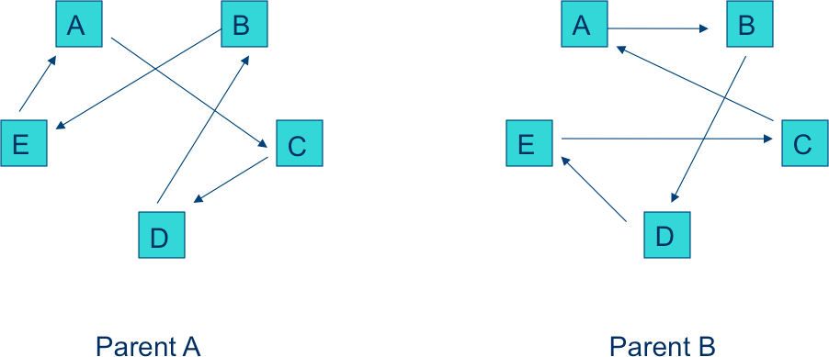
Example 2: Visualisation I
Figure: Travelling Salesman Problem with 5 cities
Artificial Intelligence (2018)

Slide 29
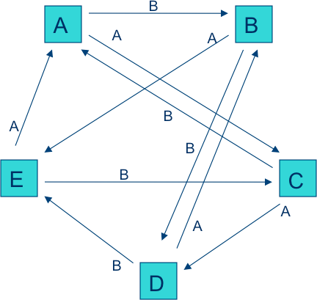
Example 2: Visualisation II
Figure: Travelling Salesman Problem with superimposed parents
Artificial Intelligence (2018)

Slide 30
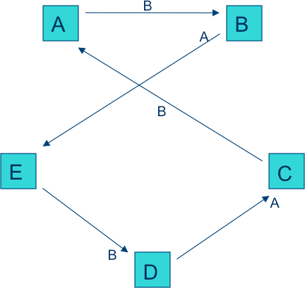
Example 2: Visualisation III
Figure: TSP’s child: after removing superfluous paths
Artificial Intelligence (2018)

Slide 31
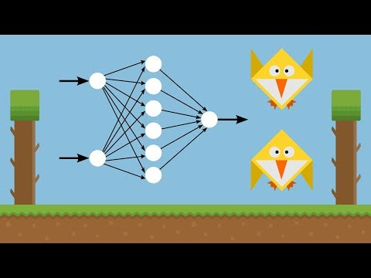
Genetic Algorithms --- Playing Games
https://www.youtube.com/watch?v=aeWmdojEJf0

Slide 32
Dynamic Programming
Notes:
Wei: You could choose wether to teach DP.

Slide 33
DP --- Have a think
Suppose the currency in the cash drawer is only 11 cents, 5 cents and 1 cent coins. If you are looking for coins for 15 cents to customers, how can you arrange them?

Slide 34

DP --- A Familiar Example
Suppose the currency in the cash drawer is only 11 cents, 5 cents and 1 cent coins. If you are looking for coins for 15 cents to customers, how can you arrange them?
Greedy:
15=1×11+4×1 (5 notes)

Slide 35
DP --- A Familiar Example
Suppose the currency in the cash drawer is only 11 cents, 5 cents and 1 cent coins. If you are looking for coins for 15 cents to customers, how can you arrange them?
Greedy (short-sighted):
15=1×11+4×1 (5 notes)
Actually you could:
15=3×5 (3 notes)

Slide 36
DP --- A Familiar Example
Analysis
If we divide the problem into:
If current money=15, and we choose 11. So the remining money would be (15-11=) 4.
If current money=15, and we choose 5. So the remining money would be (15-5=) 10.

Slide 37
DP --- A Familiar Example
Analysis
If we divide the problem into:
If current money=15, and we choose 11. So the remining money would be (15-11=) 4.
If current money=15, and we choose 5. So the remining money would be (15-5=) 10.
So we are facing a pattern: f(n) represents the least coins are required for money n.
If we choose 11, cost = f(4) + 1 = 4 + 1= 5
If we choose 5, cost = f(10) + 1 = 2 + 1 = 3

Slide 38
DP --- A Familiar Example
Now, we could make our decision
If current money=15, we choose the least coin number
If we choose 11, cost = f(4) + 1 = 4 + 1= 5
If we choose 5, cost = f(10) + 1 = 2 + 1 = 3
If we choose 1, cost = f(14) + 1 = 4 + 1 = 5

Slide 39
DP --- A Familiar Example
Now, we could make our decision
If current money=15, we choose the least coin number
If we choose 11, cost = f(4) + 1 = 4 + 1= 5
If we choose 5, cost = f(10) + 1 = 2 + 1 = 3
If we choose 1, cost = f(14) + 1 = 4 + 1 = 5
So we could draw a conclusion: f(n) is only related to f(n-11), f(n-5) and f(n-1)
f(n) = min{f(n-11), f(n-5), f(n-1)} + 1

Slide 40
Warning of Programming

Slide 41
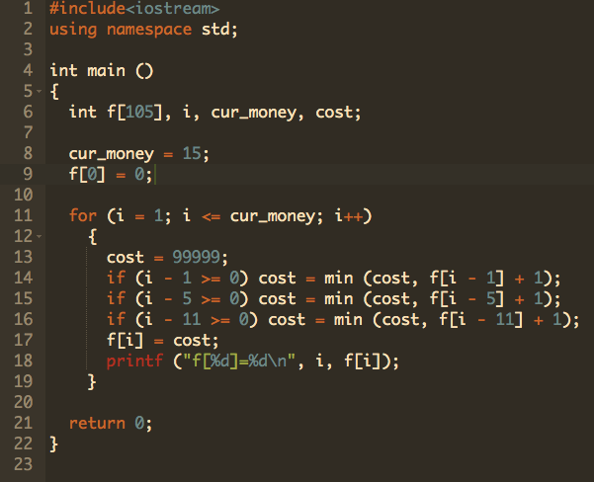
DP --- A Familiar Example

Slide 42

DP --- A Familiar Example

Slide 43
Demo

Slide 44
Reference
Mofan tutorial, https://mofanpy.com/tutorials/machine-learning/evolutionary-algorithm/intro/
Abhaya C. Nayak . COMP329 Artificial Intelligence. Macquarie University.

